Slide 1
Bright Learn Coffee Shop
Report

Slide 2
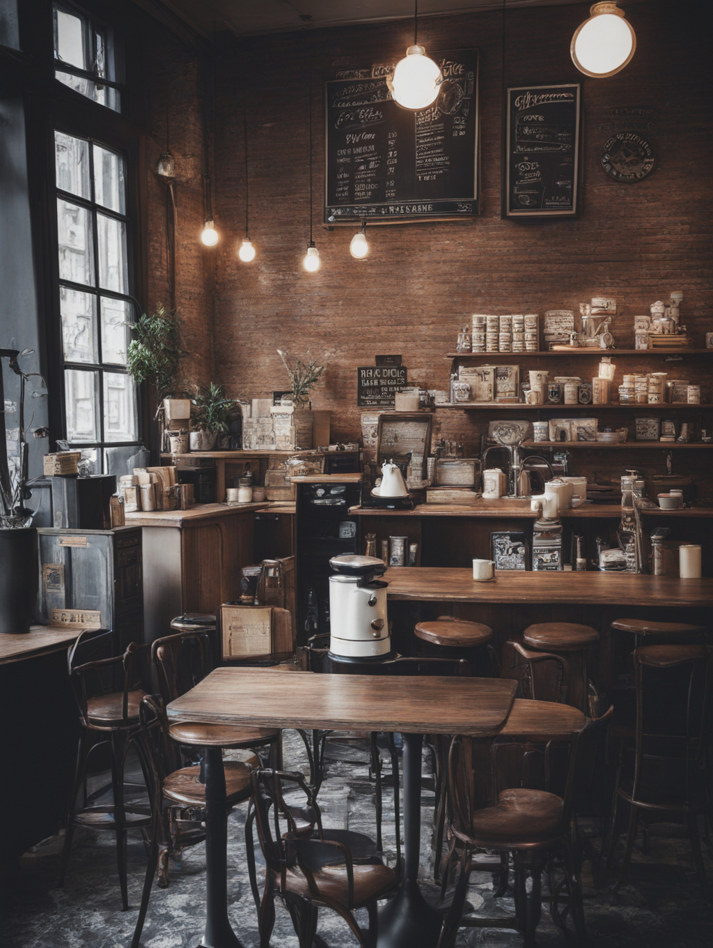
TABLE OF CONTENTS
Introduction
Data systems
Analysis
Recommendations
Implementation
Questions

Slide 3

ANALYSIS

Slide 4
$698 812.33
Total revenue from Jan – Jun 2025

Slide 5
Revenue Analysis | Store Location
Insight :Lower Manhattan generated the most revenue of 33.84 followed by Hell’s Kitchen and Astoria.

Slide 6
Monthly Revenue Analysis| Store Location
Insight: Revenue increased by 50% as the months progressed and stores generated more revenue during the cold season than the warm season.

Slide 7
Revenue Analysis |Product category revenue
Insight : Coffee, tea, bakery, drinking chocolate and coffee beans generate the most revenue.

Slide 8
Revenue Analysis: Store Location and Time of day
Insight: Lower Manhattan generates lower revenue in the evening, Hell’s kitchen in the afternoon, and Astoria during rush hour. Overall, revenue trends are lowest in the evening across locations.

Slide 9
RECOMMENDATIONS
Introduce time-based promotions to increase evening sales.
Expand seasonal beverages during warmer months.
Promote low-performing products through bundle sales
Implement loyalty cards to increase returning visits.
Motivate staff through incentives and teamwork initiatives.

Slide 10
IMPLEMENTATIONS
Introduce evening combo specials (coffee + cake) and advertise decaf options
Launch iced beverages promotions a month before summer
Provide exclusive offers to returning customers.
Reward high performing staff incentives

Slide 11

QUESTIONS

Slide 12
THANK YOU

